Slide 1

Department of Computer Science and Engineering
TEXT SUMMARIZATION METHOD
Date: 22 April 2021
S.VARSHA : 17WH1A0512
K.PRASEEDA: 17WH1A0533
D.KEERTHANA:17WH1A0555
Internal Guide : Mr . K .Rajesh
Designation: Assistant Professor

Slide 2


Abstract
Why Should I Study this course?
Examples
BVRIT HYDERABAD College of Engineering for Women
In this new era, where tremendous information is available on the internet, it is most important to provide the improved mechanism to extract the information quickly and most efficiently . It is very difficult for human beings to manually extract the summary of a large documents of text .Text summarization has become very essential to gain just the right amount of information from huge texts. Mostly, the methods described and discuss in this is produce Abstractive (ABS) or Extractive (EXT) summaries of text documents and about the structured based and semantic based approaches for summarization of the text documents.

Slide 3
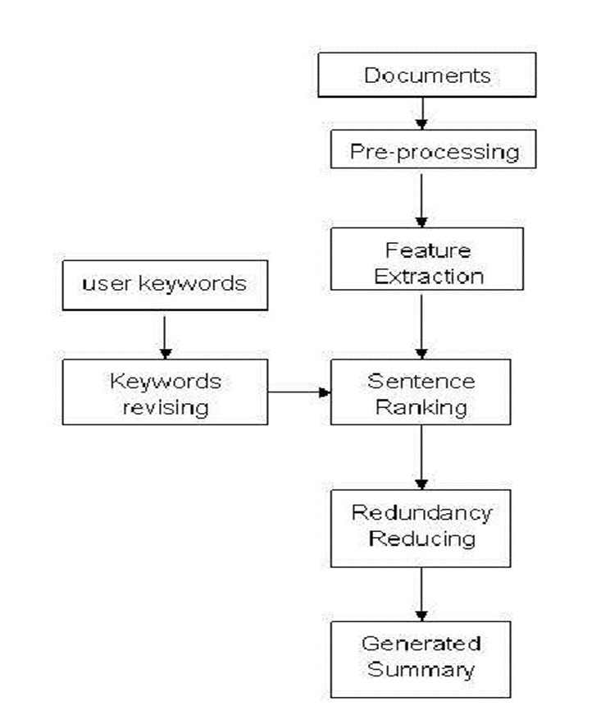
Architecture
Why Should I Study this course?
Examples
BVRIT HYDERABAD College of Engineering for Women

Slide 4
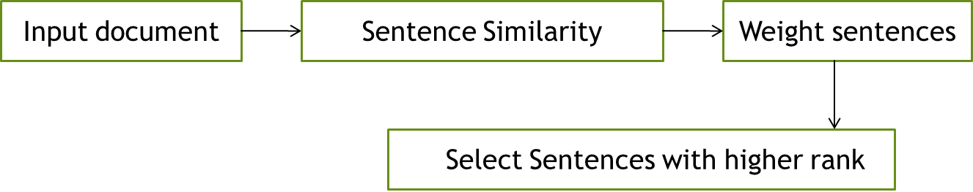
Flow Chart

Slide 5
Dataset
Why Should I Study this course?
Examples
BVRIT HYDERABAD College of Engineering for Women
Wikipedia Current Events Portal:
News events are presented as a summary with at least one link to external news articles.
The summaries must be short, up to 30-40 words, and written in complete sentences , avoiding opinions.
Summaries are written in English.
Final Dataset:
The dataset has many clusters, which we split roughly into 80% training, 10% validation and 10% test.
The split is done chronologically.

Slide 6

Technology Stack
Unsupervised learning
Cosine similarity
Algorithms:
Text Rank
Page Rank
Why Should I Study this course?
Examples
BVRIT HYDERABAD College of Engineering for Women

Slide 7
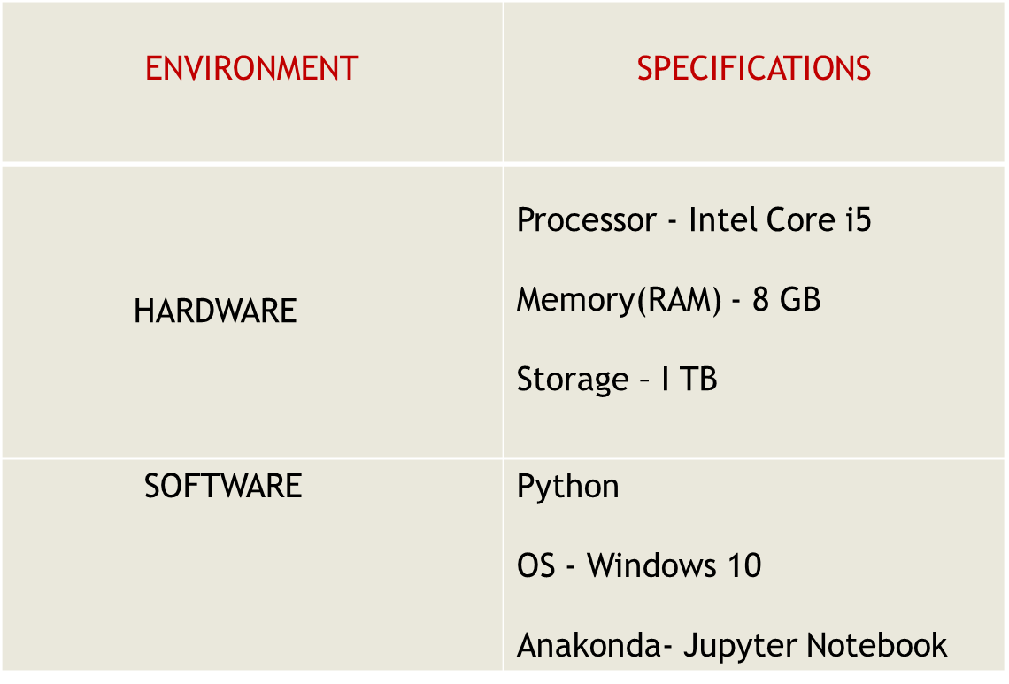
System Requirements
Why Should I Study this course?
Examples
BVRIT HYDERABAD College of Engineering for Women

Slide 8
Timeline
Why Should I Study this course?
Examples
BVRIT HYDERABAD College of Engineering for Women
Review 0 | Project Title Requirements & Speciﬁcations
Review 1 | Data Set Selection Data Stack Representation
Review 2 | Data Pre-processing Algorithm Application
Review 3 | Visualisation and Interpretation of results
 | Report of the Project

Slide 9
References
Base Paper
https://www.irjet.net/archives/V7/i4/IRJET-V7I4647.pdf
Reference
https://www.researchgate.net/publication/317420253_A_survey_on_extractive_text_summarization
https://towardsdatascience.com/a-quick-introduction-to-text-summarization-in-machine-learning-3d27ccf18a9f
https://www.aclweb.org/anthology/2020.acl-main.120.pdf
Why Should I Study this course?
Examples
BVRIT HYDERABAD College of Engineering for Women

Slide 10
Thank you

